Slide 1
AutoDMP: Automated DREAMPlace-based Macro Placement
2024/11/20
Group1

Slide 2
Outline
Introduction - AutoDMP
Review - ABCDPlace
ABCDPlace - Sequential Independent Set Matching
ABCDPlace - Concurrent Independent Set Matching
Parallel Maximal Independent Set Extraction
Parallel Partitioning with Balanced K-Means Clustering
Batch Solving for Linear Assignment Problems
ABCDPlace - Sequential Global Swap
ABCDPlace - Concurrent Global Swap
ABCDPlace - Local Reordering
Build AutoDMP
Issues
Demo Time
Appendix

Slide 3
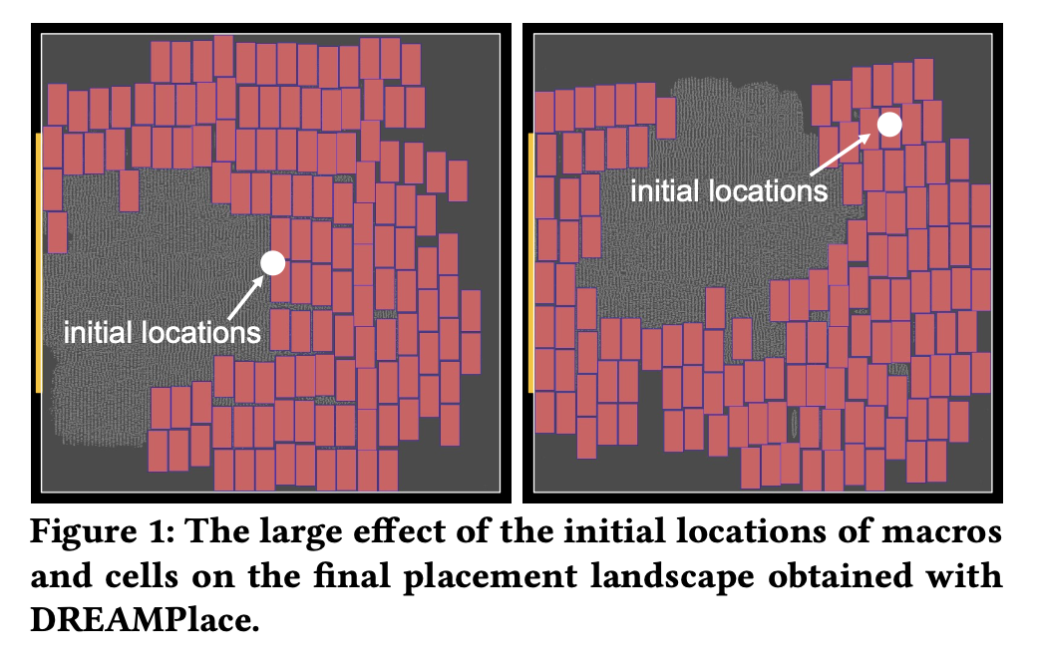
Introduction - AutoDMP
Built upon the GPU-accelerated global placer DREAMPlace and detailed placer ABCDPlace, AutoDMP adds simultaneous macro and standard cell placement enhancements and automatic parameter tuning based on multi-objective hyperparameter Bayesian optimization (MOBO).
AutoDMP
MOTPE
DreamPlace
ePlace
ABCDPlace

Slide 4
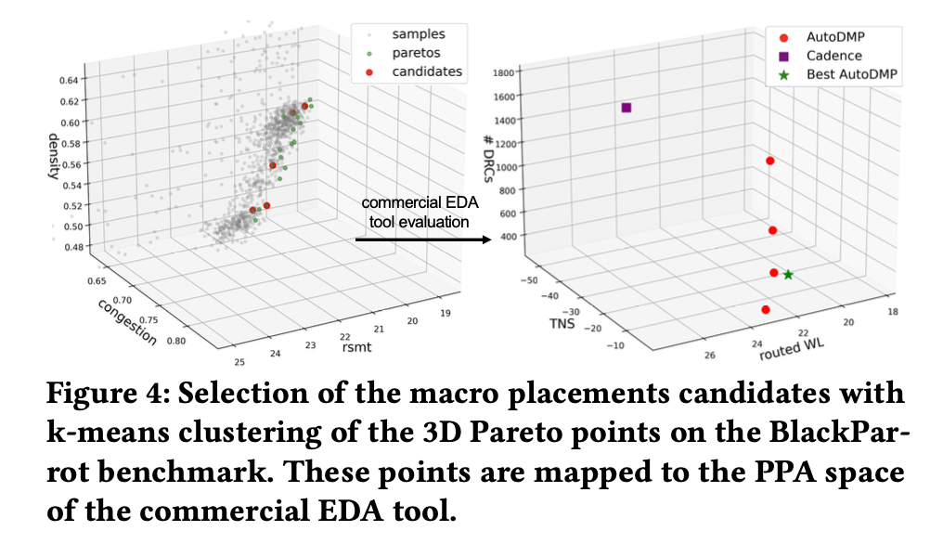
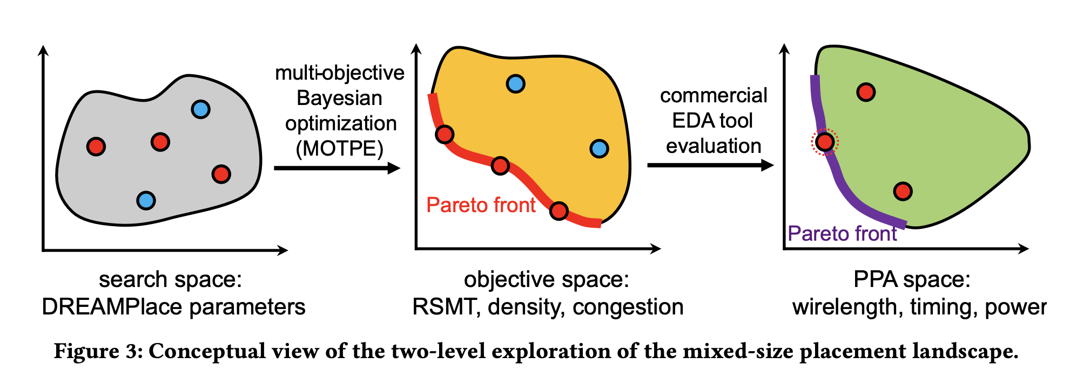
Introduction-AutoDMP
The TPE builds distributions of the “good” (𝐺) and “poor” samples (𝑃), where samples are classified based on their position in the objective space relative to the current Pareto front.
Using MOTPE to search Pareto-optimal points

Slide 5
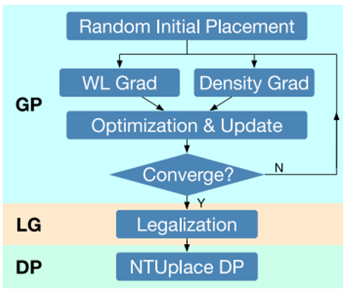
Review : ABCDPlace
ABCDPlace intorduces batch-based parallel algorithm for these widely adopted techniques, leveraging multithreading and GPU acceleration to significantly improve runtime.
Independent Set Matching
Global Swap
Local Reordering
Python, Pytorch C++ , CUDA, PYBIND11
ABCDPlace

Slide 6
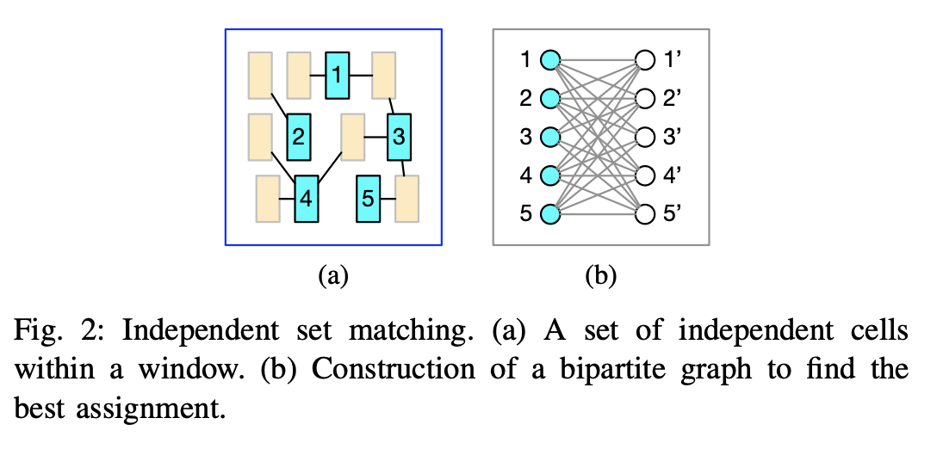
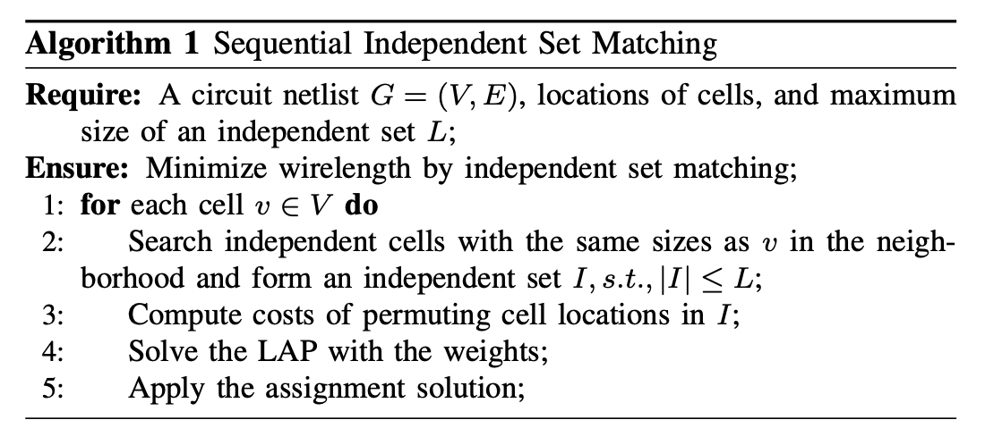
ABCDPlace - Sequential Independent Set Matching
Search independent cells, time complexity is O(|V |), if |E| is of the same magnitude as |V |
The algorithm is very difficult to parallelize, because it need to traverse all node sequentially.
Maximum size of independent set L usually limited to around 100.

Slide 7
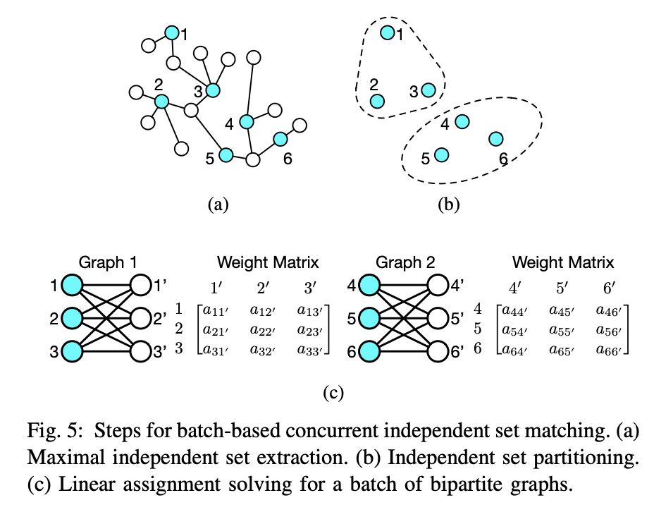
ABCDPlace - Concurrent Independent Set Matching
Parallel Maximal Independent Set Extraction
Parallel Partitioning with Balanced K-Means Clustering
Batch Solving for Linear Assignment Problems

Slide 8
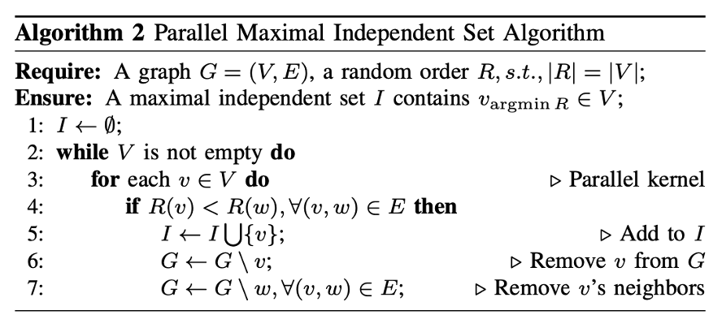
Parallel Maximal Independent Set Extraction
Blelloch’s algorithm : O(log²n)
Creates a random order: Assign a random order value to all cells.
Parallel check: Check all cells in parallel, incorprating a cell into the independent set if and only if it has minimum order value among its neighbors.
Iterative update: In each iteration, the algorithm ensure adds at least one cell into the independent set.

Slide 9
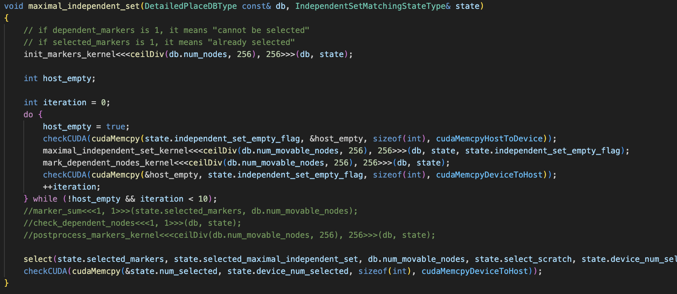
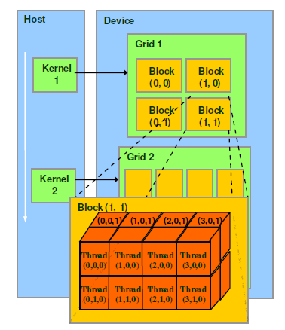
Parallel Maximal Independent Set Extraction
AutoDMP/dreamplace/ops/independent_set_matching/src/maximal_independent_set.cuh
source

Slide 10
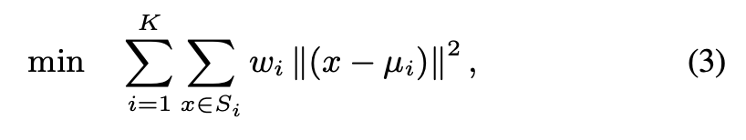
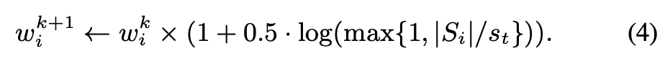
2. Parallel Partitioning with Balanced K-Means Clustering
Partition the independent set into a batch of small subsets such that cells in the same subset are physically close to each other.
Weight for each cluster is adjusted in each iteration to penalize large clusters.
2 iterations K-means is good enough
s_{t}=128,
K=L/s_{t}

Slide 11
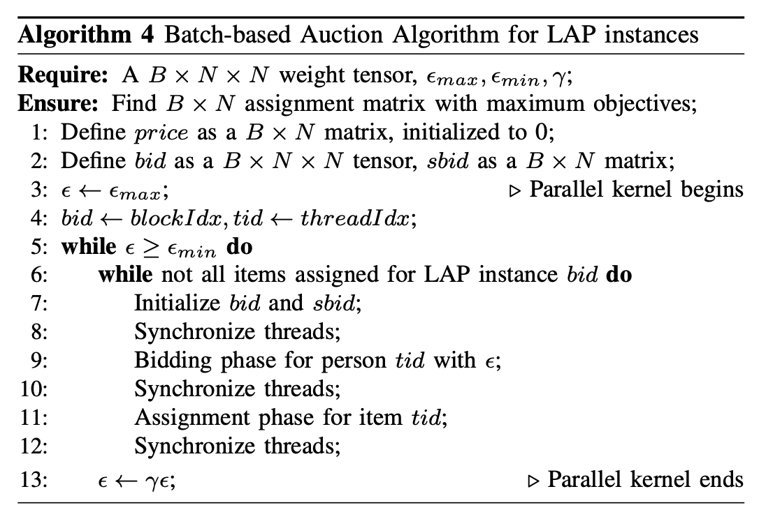
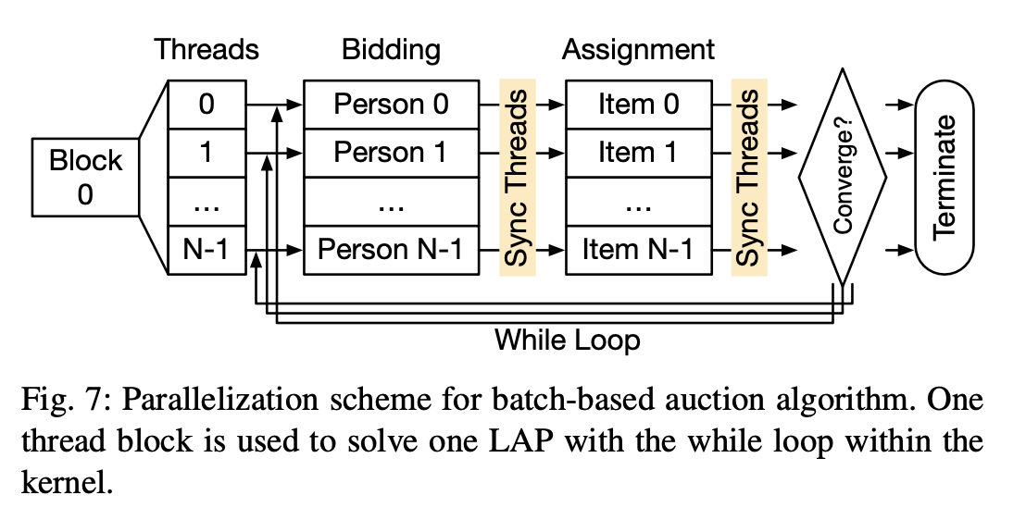
3. Batch Solving for Linear Assignment Problems
Auction algorithms consider the problem in which N persons (cells) bid for N items (locations) with a weight of a_{ij} (negative wirelength cost of assigning a cell to a location)
One instance LAP make GPU unable to compete with CPUs.

Slide 12
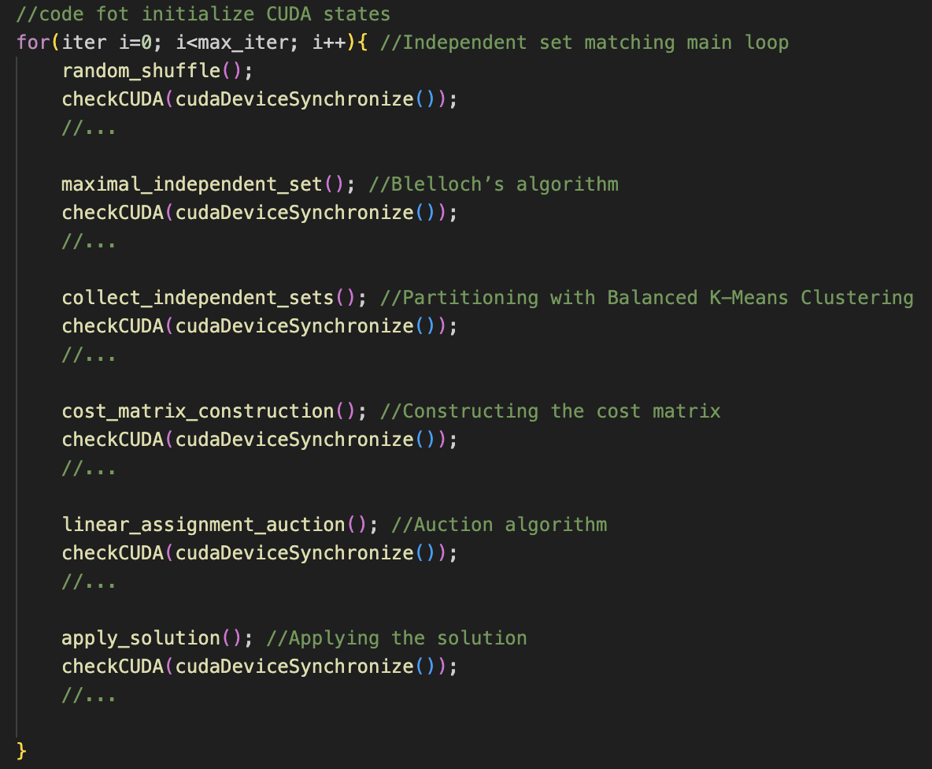
ABCDPlace - Concurrent Independent Set Matching

Slide 13
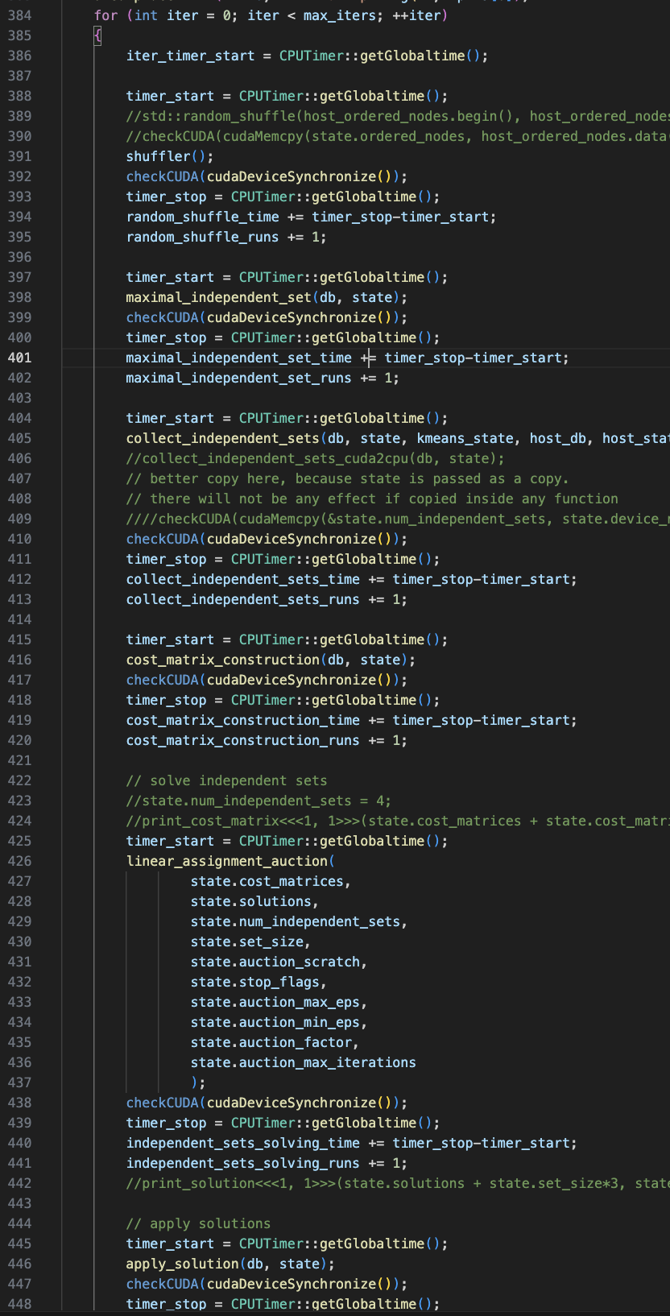
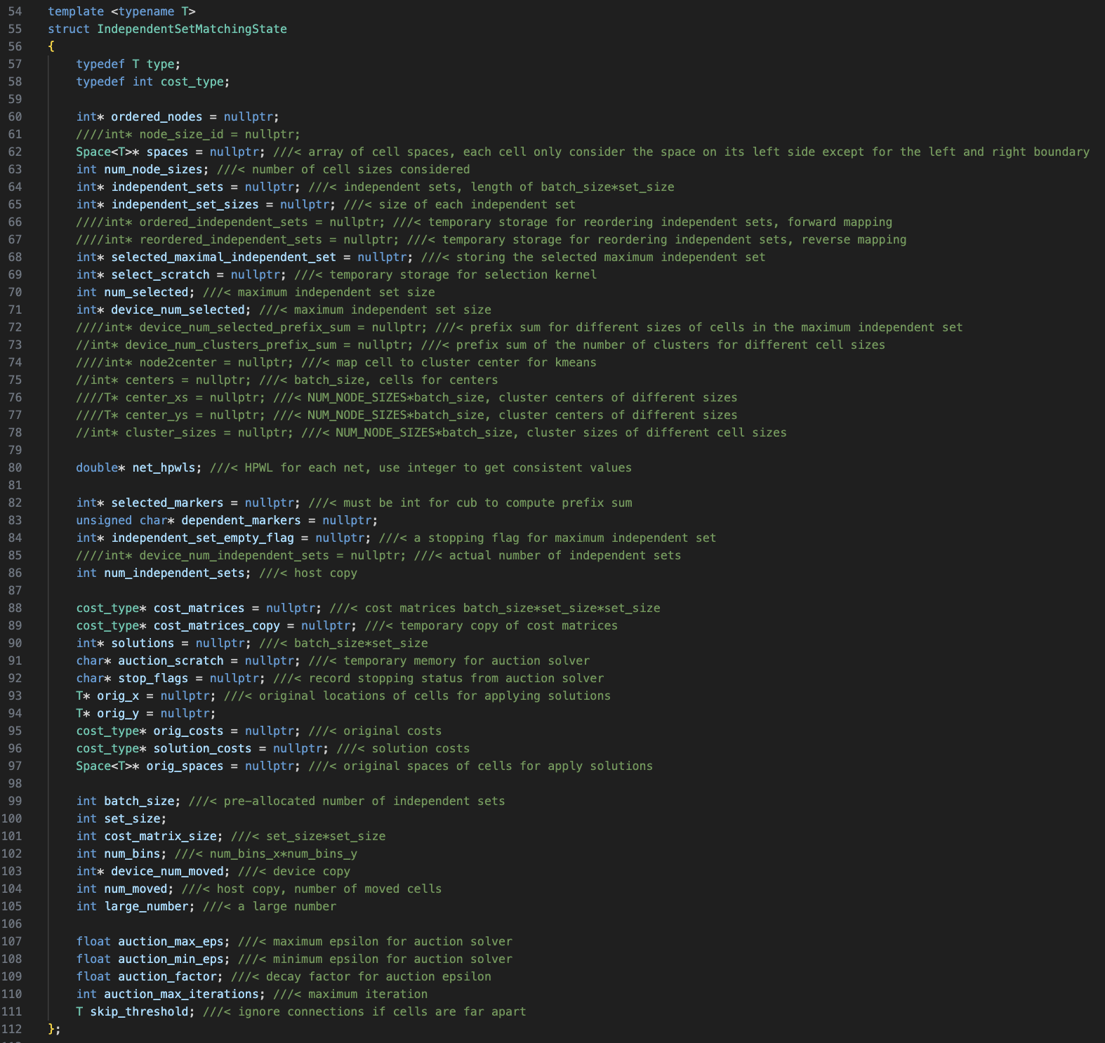
AutoDMP/dreamplace/ops/independent_set_matching/src/independent_set_matching_cuda_kernel.cu

Slide 14
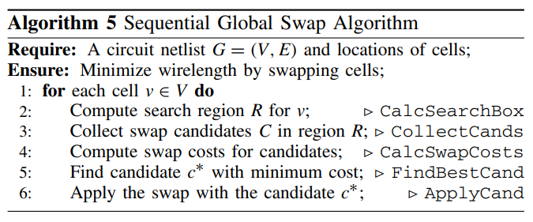

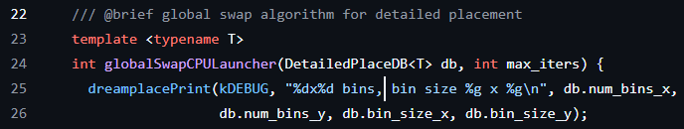
ABCDPlace - Sequential Global Swap

Slide 15
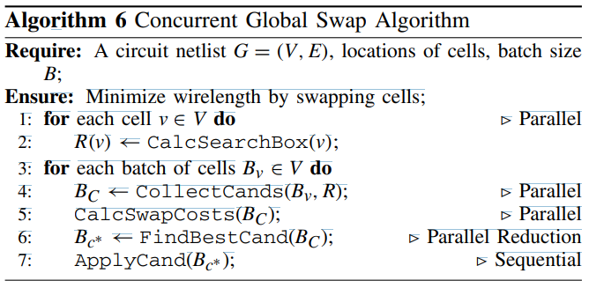
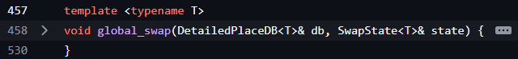
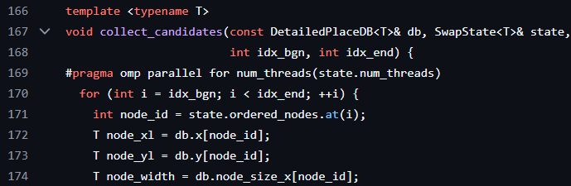
ABCDPlace - Concurrent Global Swap
multithreaded on CPU

Slide 16

ABCDPlace - Concurrent Global Swap
multithreaded on GPU

Slide 17
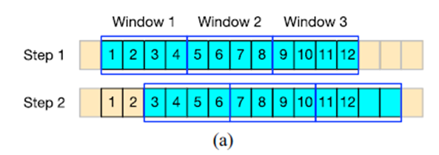
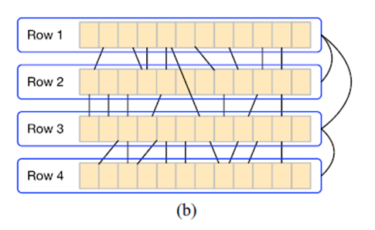
ABCDPlace - Local Reordering
Parallel Sliding Windows
Independent Rows Assumpt the most connections are local in the detailed placement.

Slide 18
Build AutoDMP
cd AutoDMP
pip install -r requirements.txt (移除 pygmo,configspace,statsmodels)
conda install pygmo
pip install configspace==0.6.0
conda install -c conda-forge statsmodels
pip install tabulate
conda install nvidia/label/cuda-11.4.0::cuda
mkdir ~/local/AutoDMP
mkdir build
cd build
cmake .. -DCMAKE_INSTALL_PREFIX=/home/user/group1/local/AutoDMP -DCMAKE_CUDA_FLAGS=-gencode=arch=compute_89,code=sm_89
make -j $(nproc)
make install

Slide 19
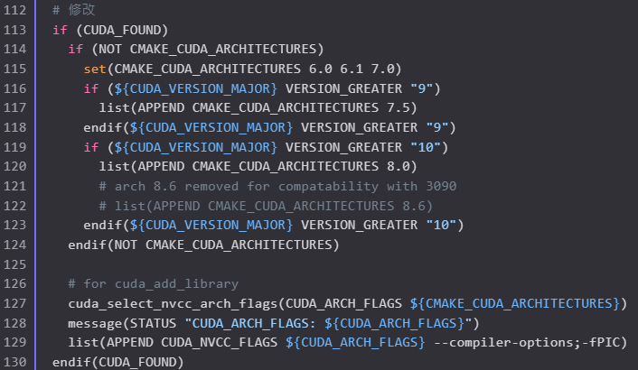
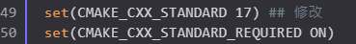
Build AutoDMP - Issues
CUDA 12.4 is not work for AutoDMP. => change to CUDA 11.4
There are many errors in the CMakeLists.txt of AutoDMP.
解法: 參考建構 DREAMPlace 源碼的 CMakeLists.txt 做修改。
主要的錯誤: Change C++14 to C++17.
需要手動調整以下資料夾到 ~/local/AutoDMP :
test
hpbanster
tuner

Slide 20
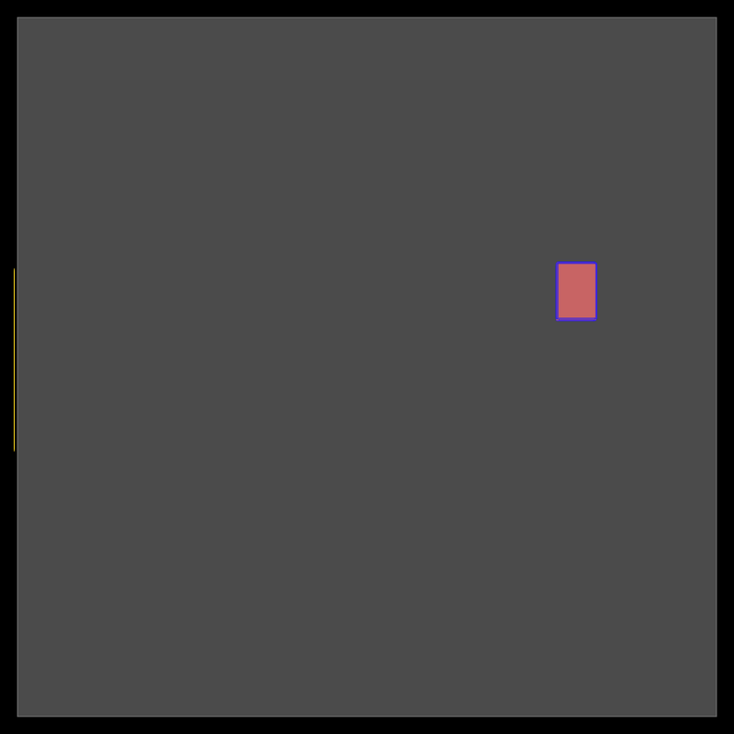
DEMO TIME

Slide 21
DEMO TIME
Run command :
./tuner/run_tuner.sh 1 1 test/nvdla_nangate45_51/configspace.json test/nvdla_nangate45_51/NV_NVDLA_partition_c.aux test/nvdla_nangate45_51/nvdla_ppa.json \"\" 20 2 0 0 10 ./tuner test/nvdla_nangate45_51/mobohb_log
參數說明:
1 : 指定使用的GPU, 1 : 啟用多目標優化
congfigspace.json : hyperparameters 的配置檔案
nvdla_ppa.json : 設定要達到的PPA指標
"" : 不使用參數重用
20 : 執行的迭代次數(優化次數), 2 : process 的數量
0 : density ratio, 0 : congestion ratio
10 : 模型中的最少數據點。(若數據點少於此數量, 就不會繼續優化參數)

Slide 22
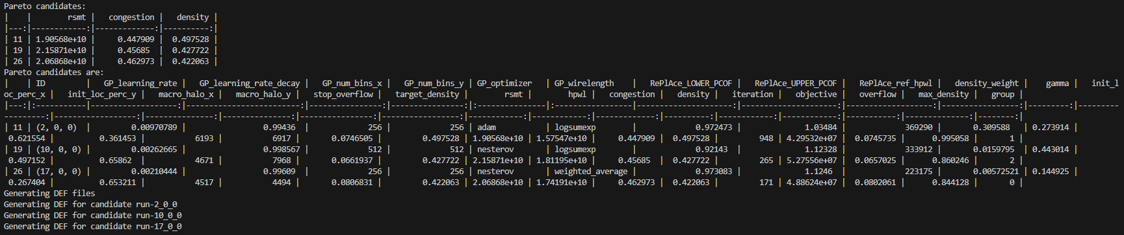
DEMO TIME
result :
n_samples = 800, num_pareto = 3

Slide 23
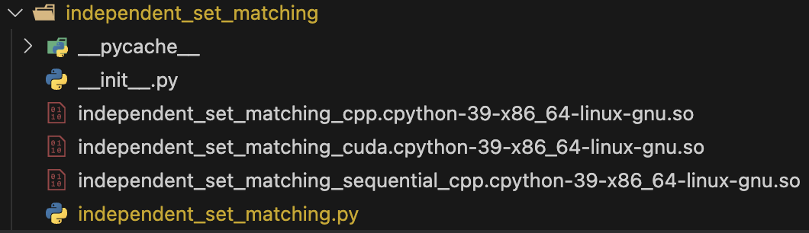
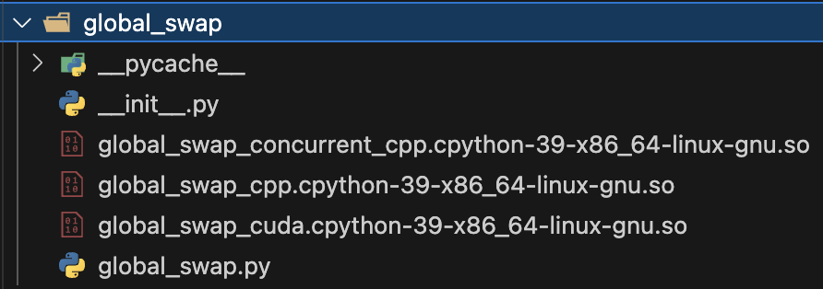
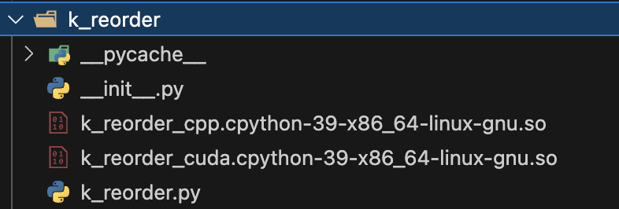
Appendix - Starting Points of ABCDPlace Code
AutoDMP/dreamplace/Placer.py : 140 -> place()
AutoDMP/dreamplace/NonLinearPlace.py : 1082 -> detailed placement
AutoDMP/dreamplace/BasicPlace.py : 1141 -> build_detailed_placement()
AutoDMP/dreamplace/ops/independent_set_matching
AutoDMP/dreamplace/ops/k_reorder
AutoDMP/dreamplace/ops/global_swap

Slide 24
Appendix - Reference
https://github.com/NVlabs/AutoDMP
https://github.com/limbo018/DREAMPlace
https://yibolin.com/publications/papers/ABCDPLACE_TCAD2020_Lin.pdf
https://arxiv.org/pdf/1202.3205

